Slide 1

Heart Disease Prediction
Ahmed
Jasleen
Simran
Bimsara
Simranjeet
Group 5:

Slide 2
Content
Methodology
Business Understanding
Data Understanding
Data Preparation
Modeling
Evaluation

Slide 3
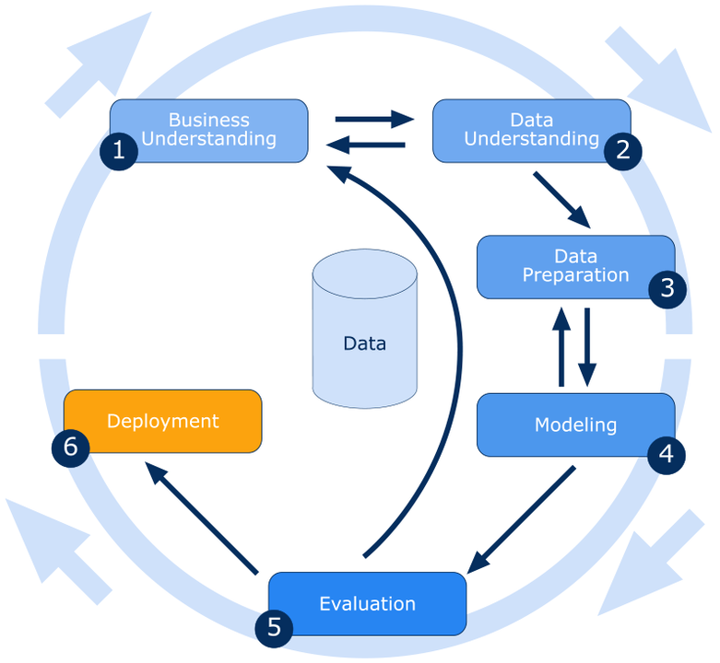
Methodology
We are using the CRISP-DM framework to guide the data mining process.
The framework consists of six phases:
Business Understanding
Data Understanding
Data Preparation
Modeling
Evaluation
Deployment

Slide 4
Business Understanding phase: Involved identifying the problem and defining the project goal.
Data Understanding phase: We gathered and explored heart health data of patients .
Data Preparation phase: Involved transforming, and preparing the data for modeling.
Modeling phase: Involved building and testing machine learning models to predict whether the current health conditions and parameters indicate potential threat of heart disease or not.
Evaluation phase: Involved comparing the performance of the different models and selecting the best one.

Slide 5
Business Understanding
Heart related diseases are increasing it gets further difficult to diagnose and start treatment at early stage.
The objective of this project is to test ML models for heart disease prediction based on the related parameters.
Machine learning is increasingly utilized within the field of cardiovascular medicine. This work presents machine learning approaches for predicting heart diseases, using data of major health factors from patients.

Slide 6
Data Understanding
The first step in the project is to collect a large dataset of heart health data.
This step is critical to the success of the project, as the accuracy and completeness of the data will directly impact the performance of the predictive model.
The data to be worked upon was obtained from below:
https://www.kaggle.com/datasets/alexteboul/heart-disease-health-indicators-dataset

Slide 7
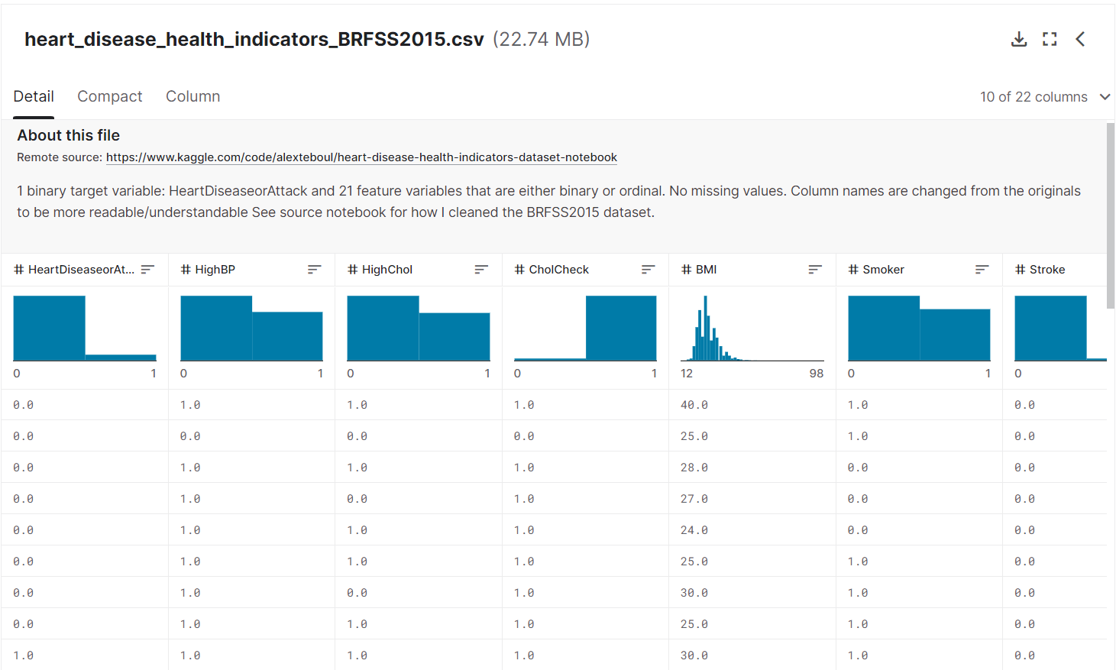
In this project we use following dataset from Kaggle.
(Kaggle is an online platform for data scientists and machine learning enthusiasts that offers access to public datasets, tools for data analysis and visualization, and a community of over 4 million experts)

Slide 8
Some of the most important data factors are:
Health vitals data: high BP, high cholesterol, diabetes, or a person suffered from stroke etc.
Lifestyle: BMI, smoker or non-smoker, physically active etc.
Person specific data: age, mental health, education, income etc. along with other important factors.
Dietary factors: fruits or veggies, whether the person consumes alcohol etc.

Slide 9
Data Preparation
The data collected needs to be transformed and processed using Python and related tools to ensure that it is in a format suitable for analysis and storage in MongoDB.
This process involves identifying missing or erroneous data, removing duplicates if found, and transforming data types and values as necessary.
Once the data is cleaned and the schema is designed, the data will be imported into MongoDB using tools such as PyMongo or MongoDB Compass.

Slide 10
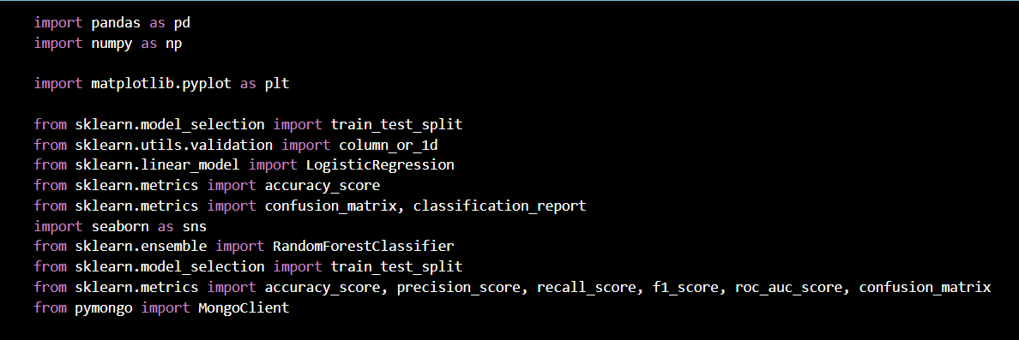
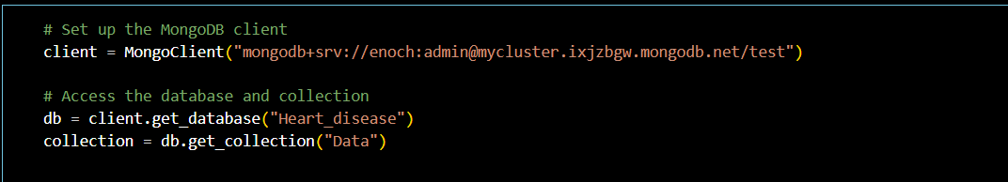
These are the steps we followed to prepare the data
Import necessary libraries
2. Create a database and collection

Slide 11
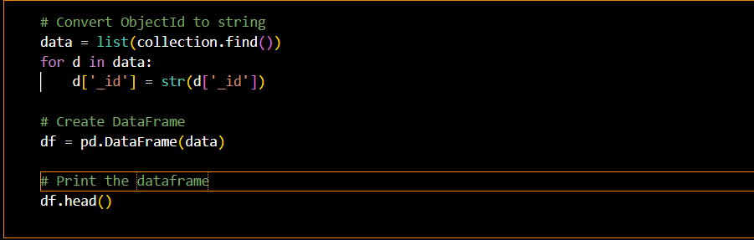
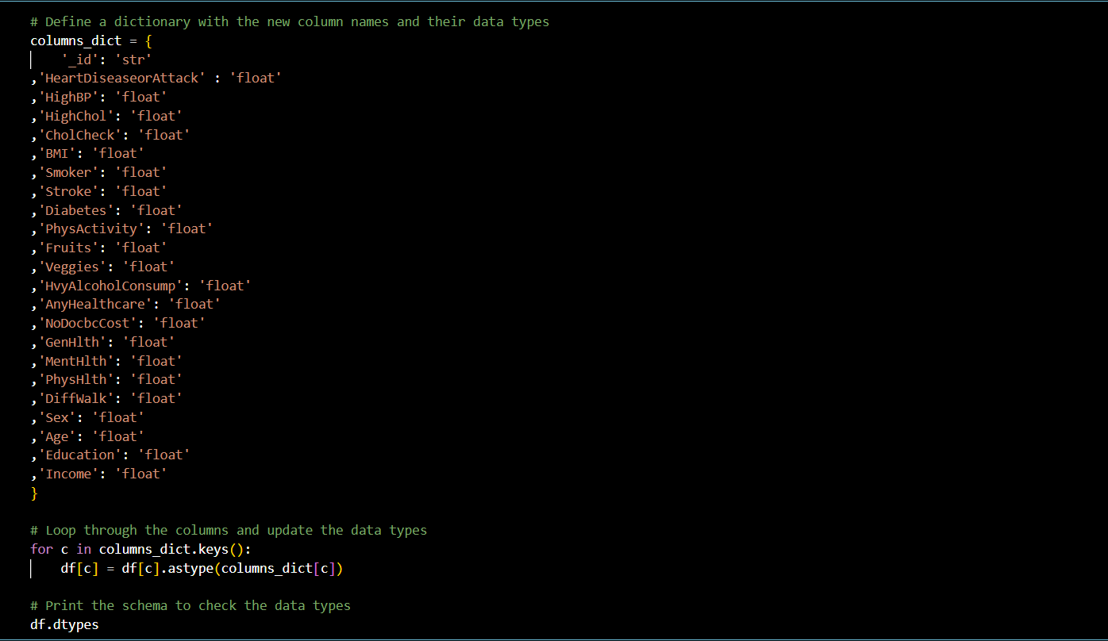
3. Process data- Creating Data frame
4. Changing data types of all columns

Slide 12
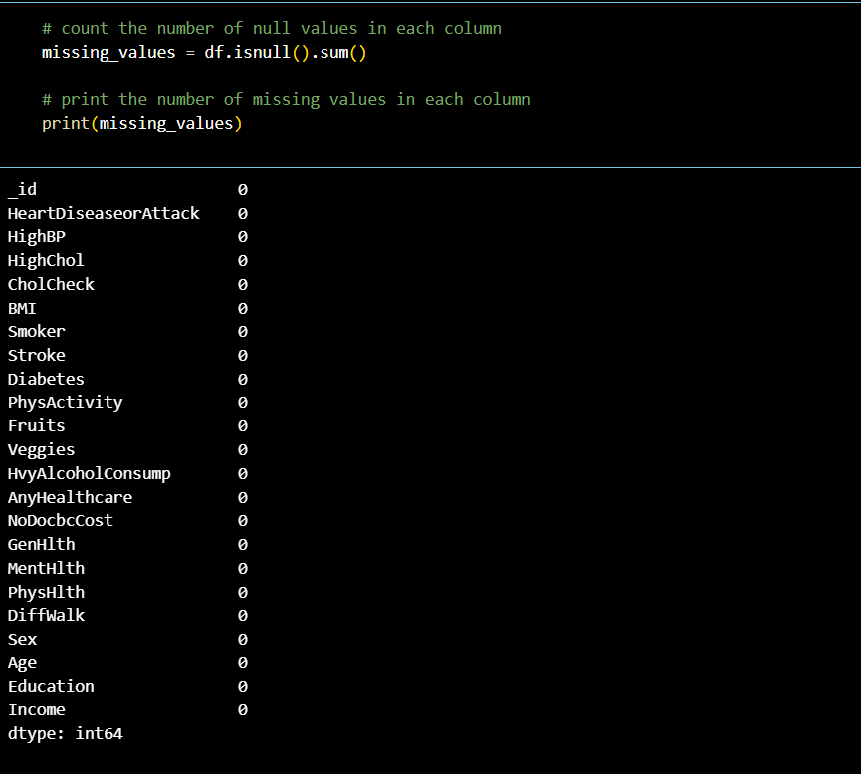
5. Checking for all missing values with Zero

Slide 13
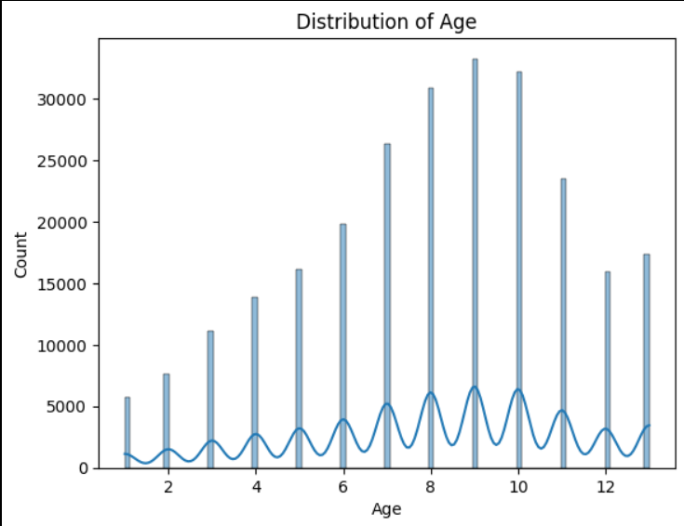
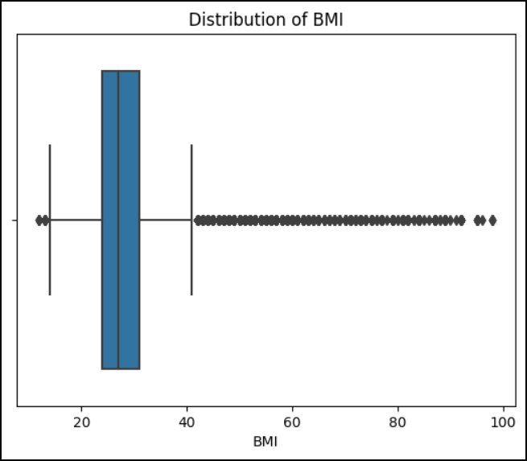
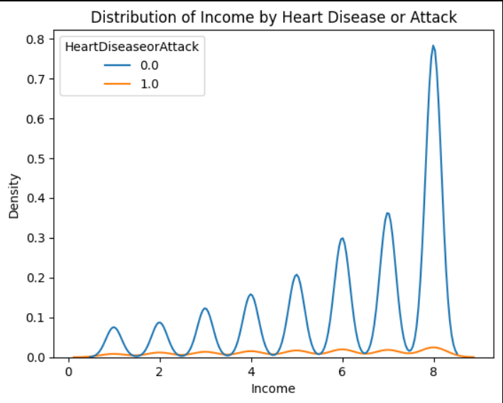
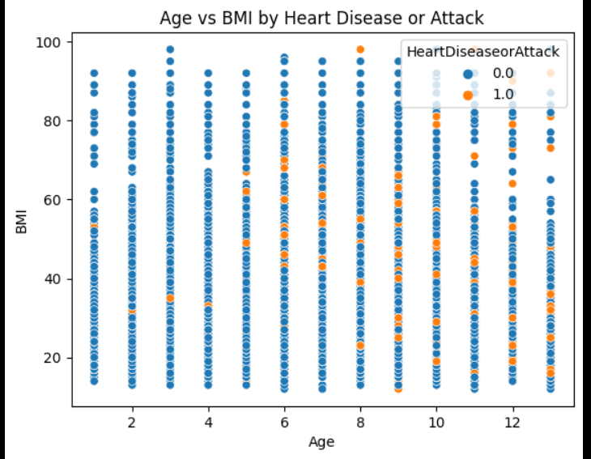
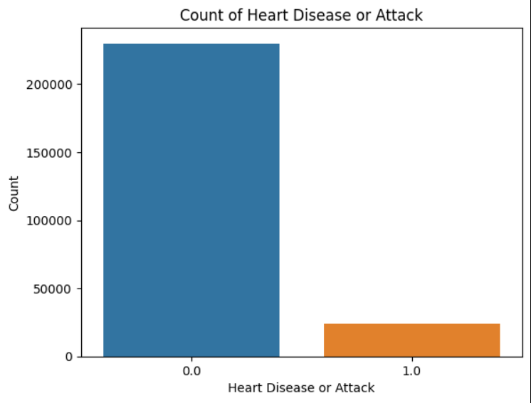
6. Plotting data

Slide 14
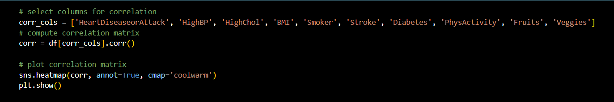
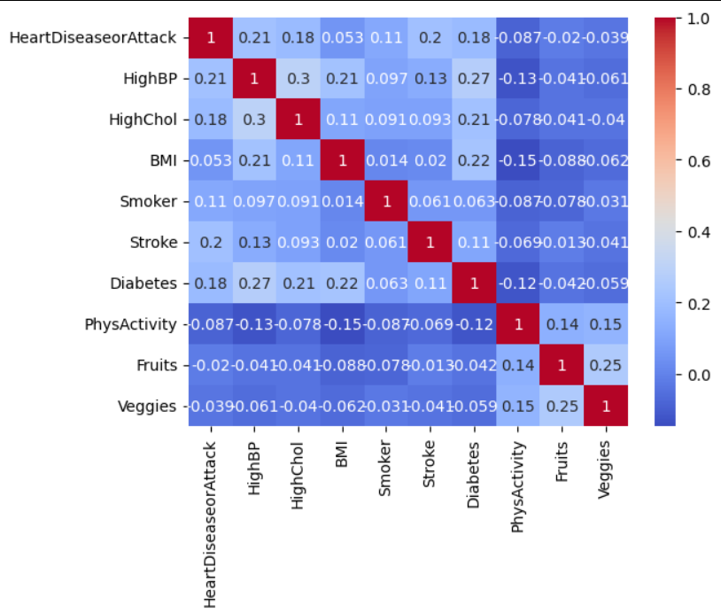
7. Generating a heatmap that displays the correlation of features in the DataFrame with the target feature.

Slide 15
Modelling
The conceptual framework of ML is based on models that receive input data (e.g., images or text) and through a combination of mathematical optimization and statistical analysis predict outcomes
Here, ML models predict under which conditions patients are likely to be prone to heart disease.
We implemented two models here: Logistic Regression and Random forest classifier
The feature variables are assigned to x and the target variable to y. The data is split into training and testing sets using the train_test_split function from the sklearn library. This allows the model to be trained on a subset of the data and evaluated on a separate subset.

Slide 16
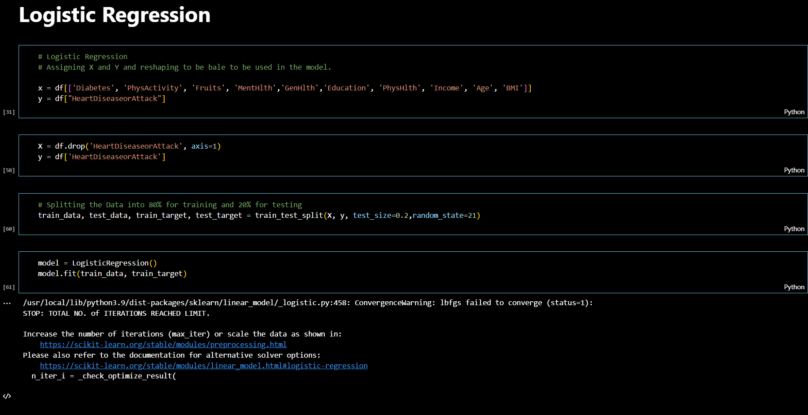
Modelling using Logistic Regression

Slide 17
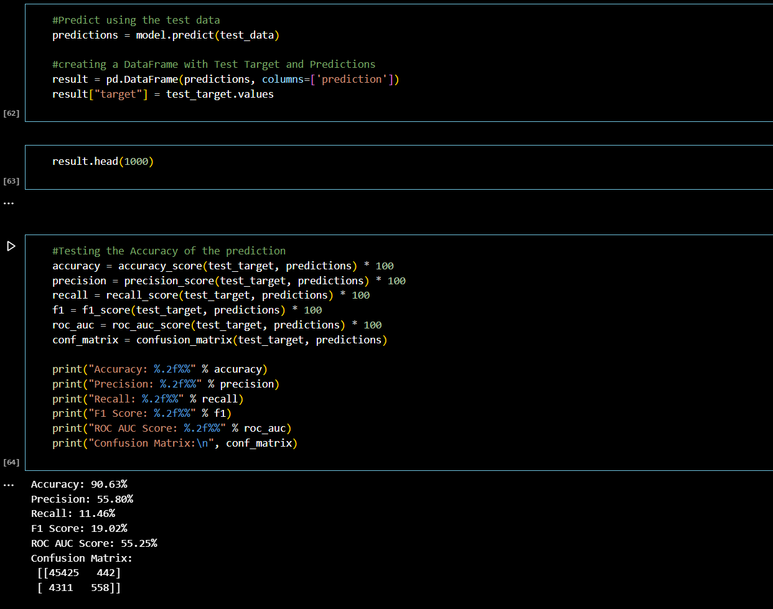
Results achieved

Slide 18
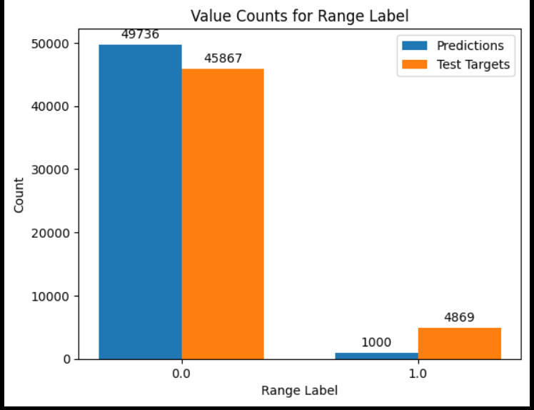
Plotting the results achieved:

Slide 19
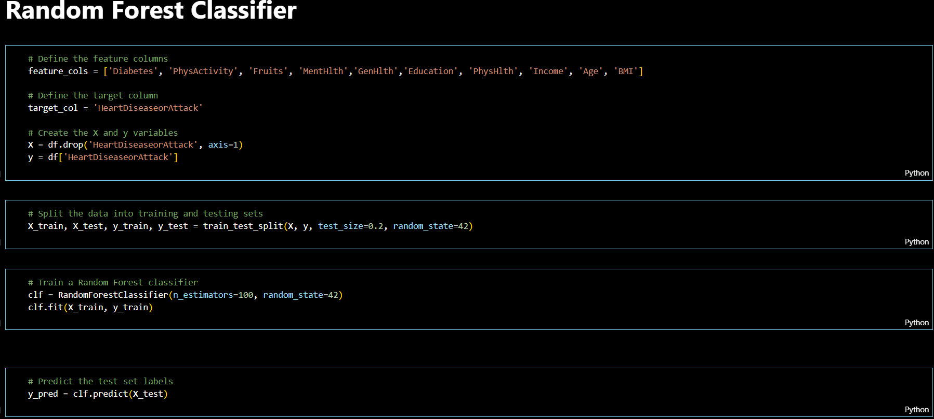
Modelling using Random Forest Classifier

Slide 20
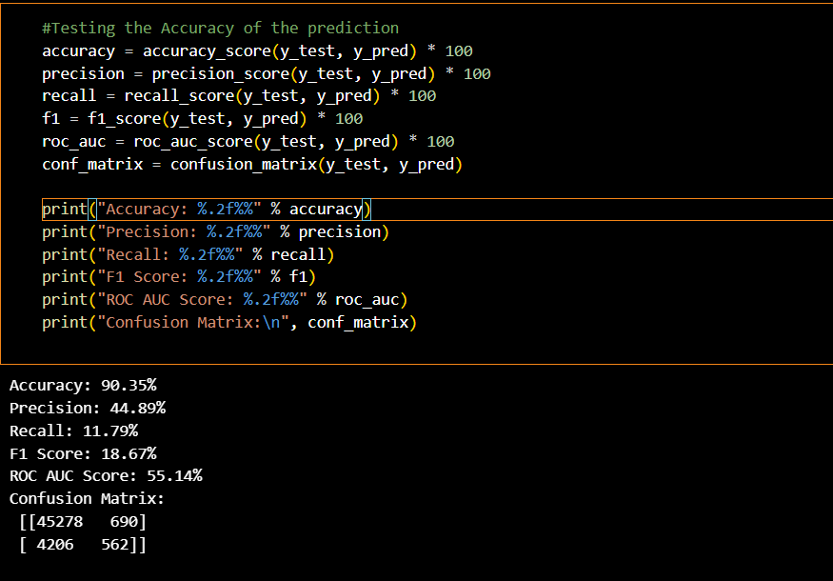
Results achieved

Slide 21
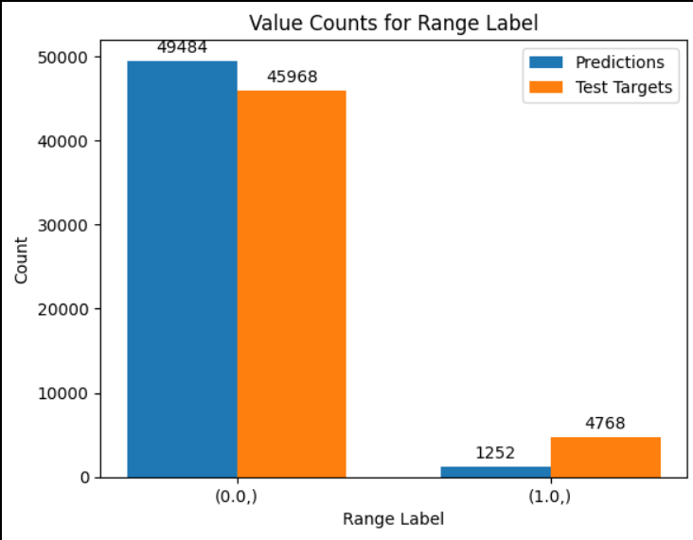
Plotting the results achieved:

Slide 22
Evaluation
Evaluation is important in CRISP to determine accuracy and effectiveness of model
Compares predicted outcomes with actual outcomes to see model's performance
Techniques used include confusion matrices, ROC AUC, precision, recall and F1-score
Evaluation ensures model meets required standards and can predict chances of heart disease accurately
Helps identify areas for improvement/refinement to achieve better results

Slide 23
Evaluation Metrics for Logistic Regression Model
Accuracy: 90.63% - How accurate is the model?
Precision: 55.80% - How many did we predict true and were right ?
Recall: 11.46% - How many did we guess out of the actual positive?
F1 Score: 19.02% - How good is the model at identifying positive cases?
ROC AUC Score: 55.25% - How well can it tell the difference?
Confusion Matrix:
 | Predicted Negatives | Predicted Positive
Actual Negative | 45425 | 442
Actual Positive | 4311 | 558
Notes:
The accuracy of the model is 80.88%, which means that 80.88% of the predictions made by the model were correct. The precision score of 49.43% indicates that only about half of the positive predictions made by the model were actually true positives. The recall score of 1.81% indicates that the model correctly identified only a very small proportion of the actual positive cases. The F1 score, which takes into account both precision and recall, is 3.49%. The ROC AUC score of 50.69% indicates that the model's performance is only slightly better than random guessing. The confusion matrix shows that the model correctly classified 40267 negative cases and 173 positive cases, but incorrectly classified 9383 positive cases as negative and 177 negative cases as positive. Overall, the model's performance is poor and may require further refinement to improve its accuracy and predictive power.

Slide 24
Evaluation Metrics for Random Forest Classifier
Accuracy: 90.35%
Precision: 44.89%
Recall: 11.79%
F1 Score: 18.67%
ROC AUC Score: 55.14%
Confusion Matrix:
 | Predicted Negatives | Predicted Positive
Actual Negative | 45278 | 690
Actual Positive | 4206 | 562
Notes:
The accuracy of the model is 81.19%, which indicates that 81.19% of the predictions made by the model were correct. The precision score of 49.65% indicates that only about half of the positive predictions made by the model were actually true positives. The recall score of 12.95% indicates that the model correctly identified only a small proportion of the actual positive cases. The F1 score, which takes into account both precision and recall, is 20.54%. The ROC AUC score of 54.96% indicates that the model's performance is slightly better than random guessing. The confusion matrix shows that the model correctly classified 39378 negative cases and 1216 positive cases, but incorrectly classified 8173 positive cases as negative and 1233 negative cases as positive. Overall, the model's performance is better than the logistic regression model, but still has room for improvement to increase its accuracy and predictive power.

Slide 25
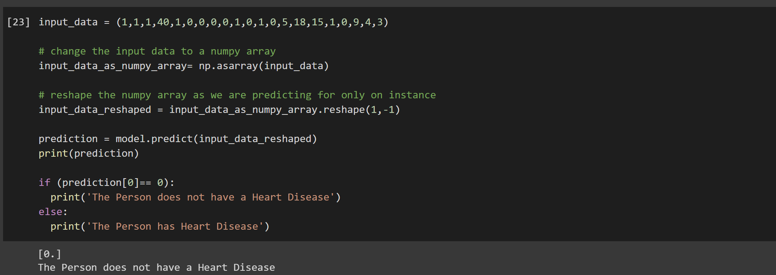
Running Model on Sample input
Notes:
The accuracy of the model is 81.19%, which indicates that 81.19% of the predictions made by the model were correct. The precision score of 49.65% indicates that only about half of the positive predictions made by the model were actually true positives. The recall score of 12.95% indicates that the model correctly identified only a small proportion of the actual positive cases. The F1 score, which takes into account both precision and recall, is 20.54%. The ROC AUC score of 54.96% indicates that the model's performance is slightly better than random guessing. The confusion matrix shows that the model correctly classified 39378 negative cases and 1216 positive cases, but incorrectly classified 8173 positive cases as negative and 1233 negative cases as positive. Overall, the model's performance is better than the logistic regression model, but still has room for improvement to increase its accuracy and predictive power.

Slide 26
Future enhancements
Increasing dataset size: Collecting more data to train the model
Feature engineering: Identifying new features
Incorporating external data sources: Utilizing external data sources.
Deploying the model: Implementing the model into a production environment

Slide 27
References
Heart Disease Health Indicators Dataset
253,680 survey responses from cleaned BRFSS 2015 - binary classification
https://www.kaggle.com/datasets/alexteboul/heart-disease-health-indicators-dataset

Slide 28
Thank You

